Slide 1
Contrastive Learning
Xiaoyu Li
2020.5.22

Slide 2
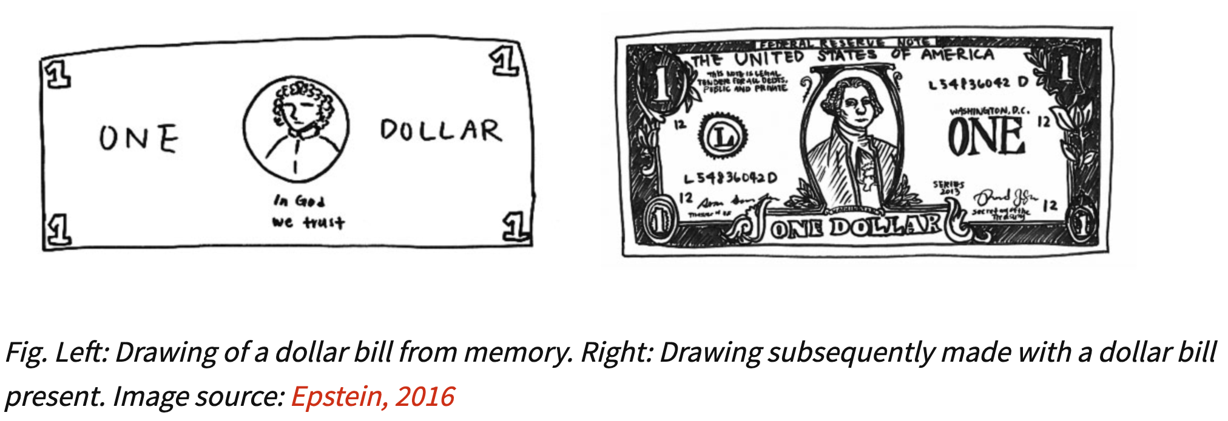
An illustrative example
Despite having seen a dollar bill countless number of times, we don’t retain a full representation of it. In fact, we really only retain enough features of the bill to distinguish it from other objects.

Slide 3
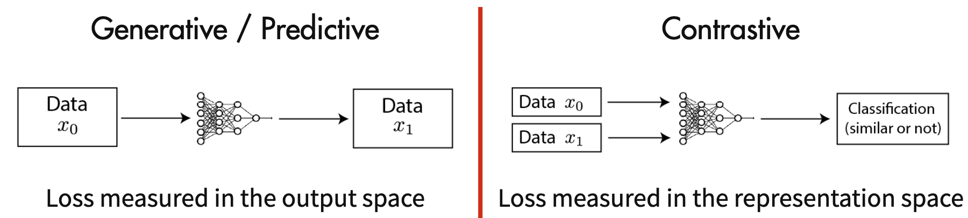
Generative vs Contrastive Methods
Contrastive methods aim to learn representations by enforcing similar elements to be equal and dissimilar elements to be different.

Slide 4
Generative vs Contrastive Methods
x1
X1’
Encoder
z1
Encoder
Same or not ?
Loss: Reconstruction Error
x1
Encoder
z1
Similar / Dissimilar?
x2
Encoder
z2

Slide 5
Generative vs Contrastive Methods
x1
Encoder
z1
Similar / Dissimilar?
x2
Encoder
z2
Two problems remain:
What is the loss?
How to get (x1, x2)?

Slide 6
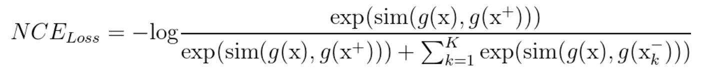
Noise Contrastive Estimator(NCE) Loss
sim(): function to measure similarity (Often, sim(.) is defined in terms of dot products or cosine similarities)
g(): encoder to map instance to its representation
x: commonly referred to as an anchor data point
x+: similar sample to x
x-: dissimilar sample to x
Then, key question is how to construct positive pair and negative pair.

Slide 7
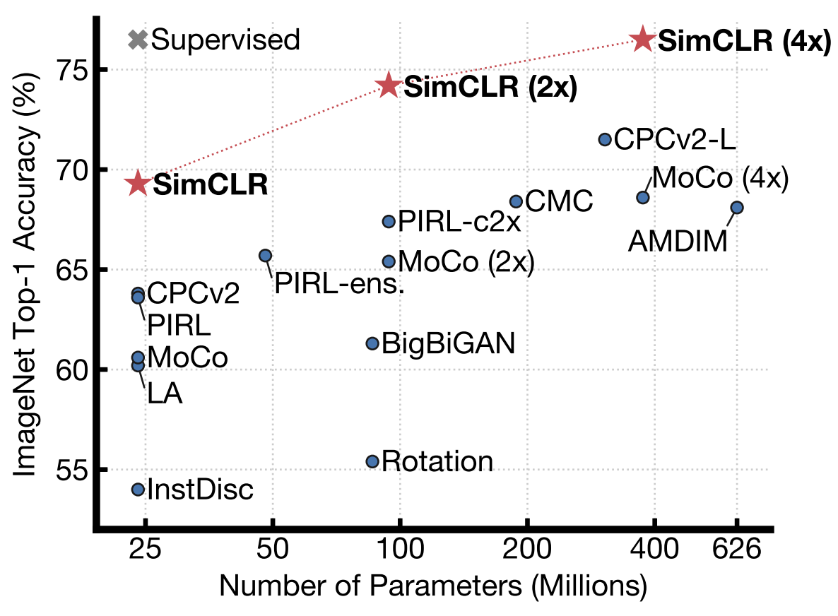
A Simple Framework for Contrastive Learning of Visual Representations(SimCLR)
ResNet50; Others: linear classification
Geoffrey Hinton
2020

Slide 8
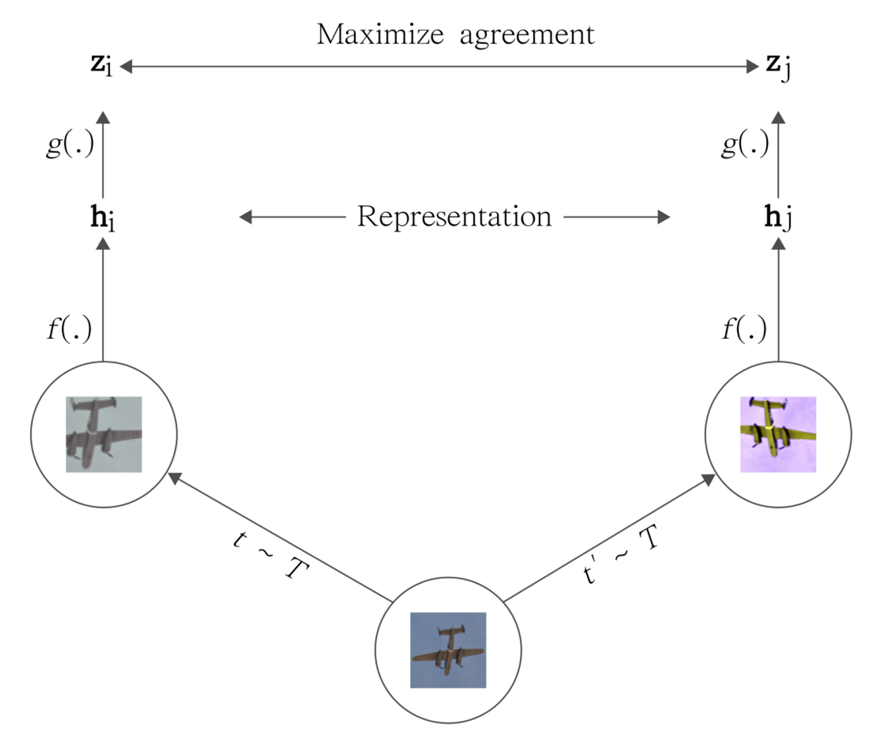
SimCLR
g(.): non-linear transformation
f(.): encoder
t~T: augmentation

Slide 9

SimCLR

Slide 10
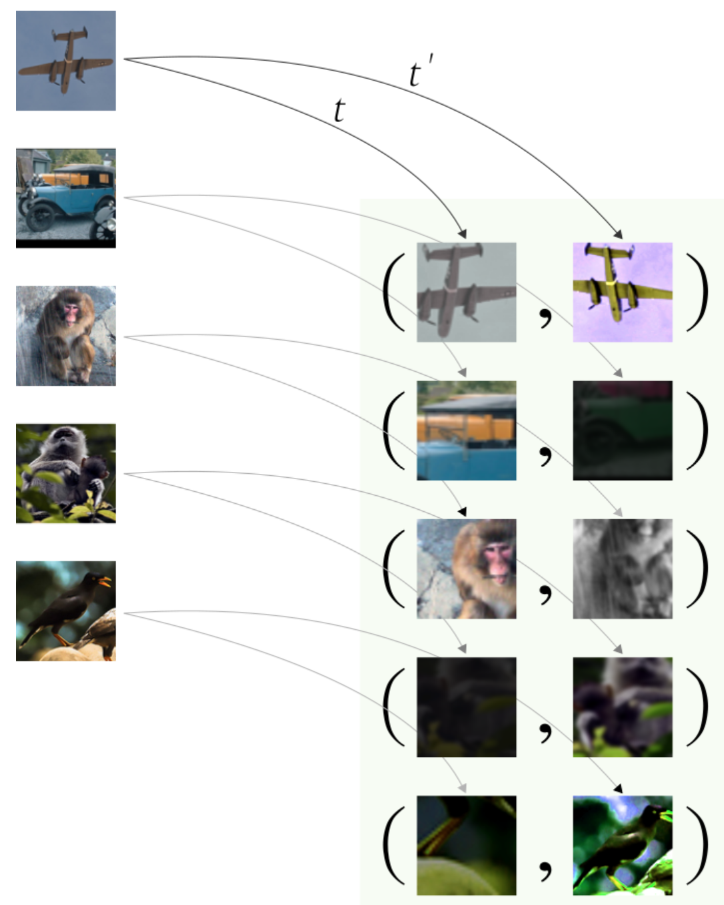
SimCLR Positive pairs
Augmentation

Slide 11
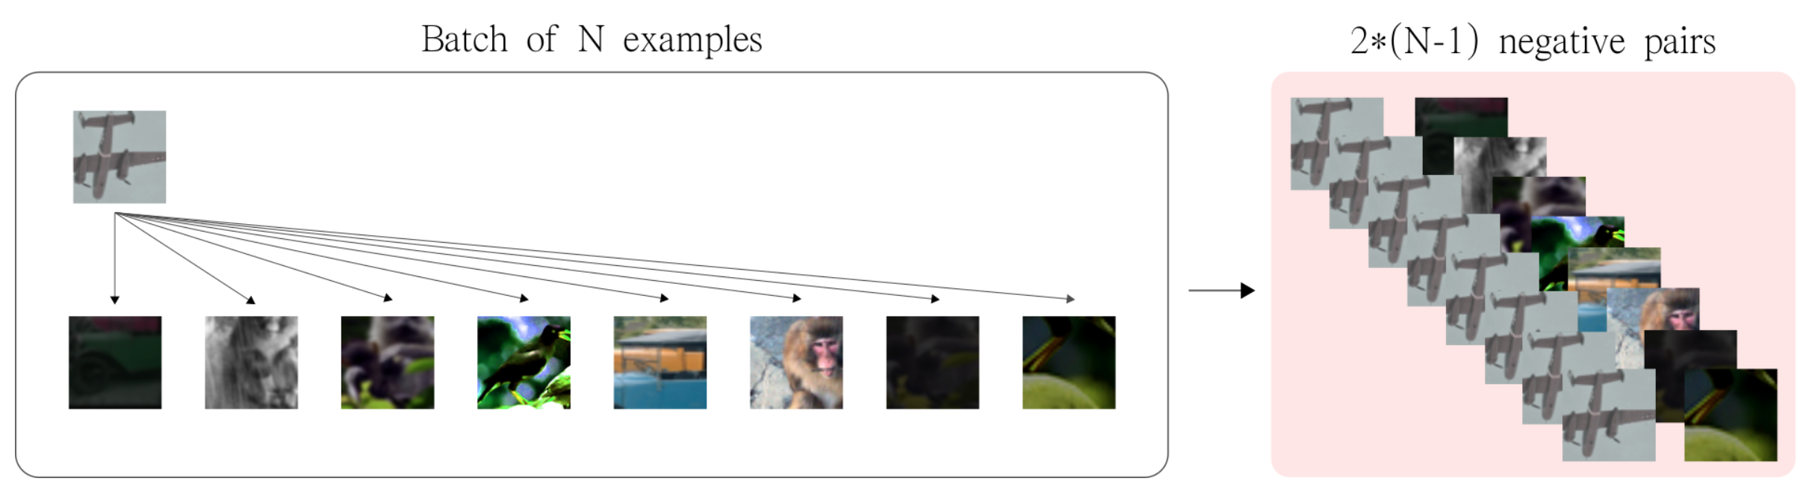
SimCLR Negative pairs

Slide 12
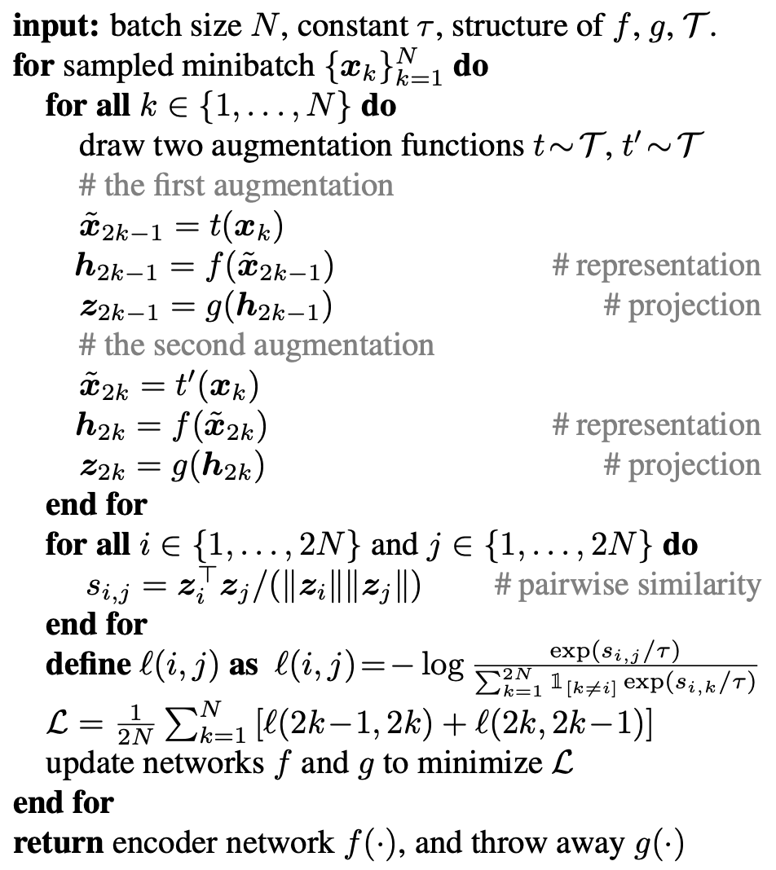
SimCLR
Algorithm
Cosine similarity
Loss

Slide 13
SimCLR
Composition of data augmentations plays a critical role in defining effective predictive tasks
Introducing a learnable nonlinear transformation between the representation and the contrastive loss substantially improves the quality of the learned representations
Contrastive learning benefits from larger batch sizes and more training steps compared to supervised learning

Slide 14
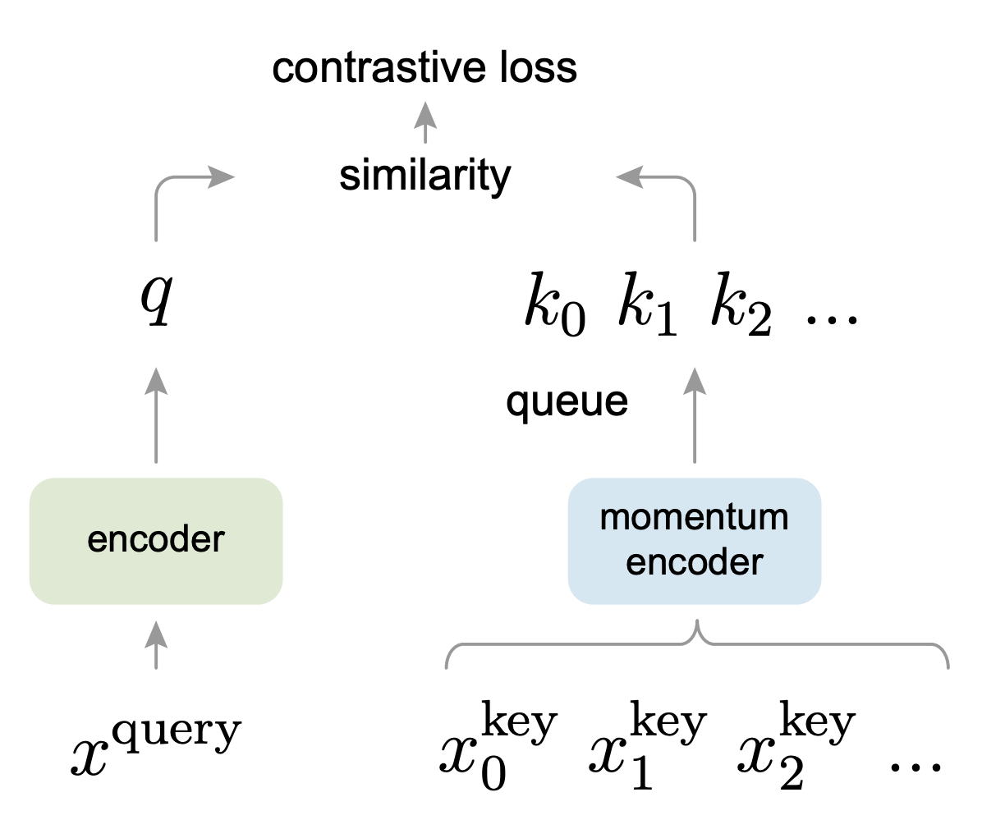
Momentum Contrast for Unsupervised Visual Representation Learning (MoCo)
Kaiming He
2020
MoCo can outperform its supervised pre-training counterpart in 7 detection/segmentation tasks on PASCAL VOC, COCO, and other datasets, sometimes surpassing it by large margins

Slide 15
MoCo
From the perspective of dictionary !
Why does BERT work?
Language tasks have discrete signal spaces (words, sub-word units, etc.) for building tokenized dictionaries, on which unsupervised learning can be based. Computer vision, in contrast, further concerns dictionary building [54, 9, 5], as the raw signal is in a continuous, high-dimensional space and is not structured for human communication (e.g., unlike words).
How the dictionary is supposed to be?
Large
Consistent as they evolve during training

Slide 16
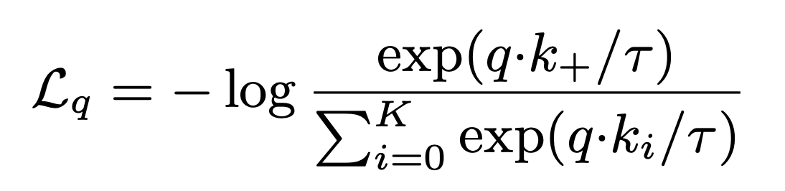
MoCo loss
Contrastive learning, and its recent developments, can be thought of as training an encoder for a dictionary look-up task.
Consider an encoded query q and a set of encoded samples {k0, k1, k2, ...} that are the keys of a dictionary.
τ is a temperature hyper-parameter

Slide 17
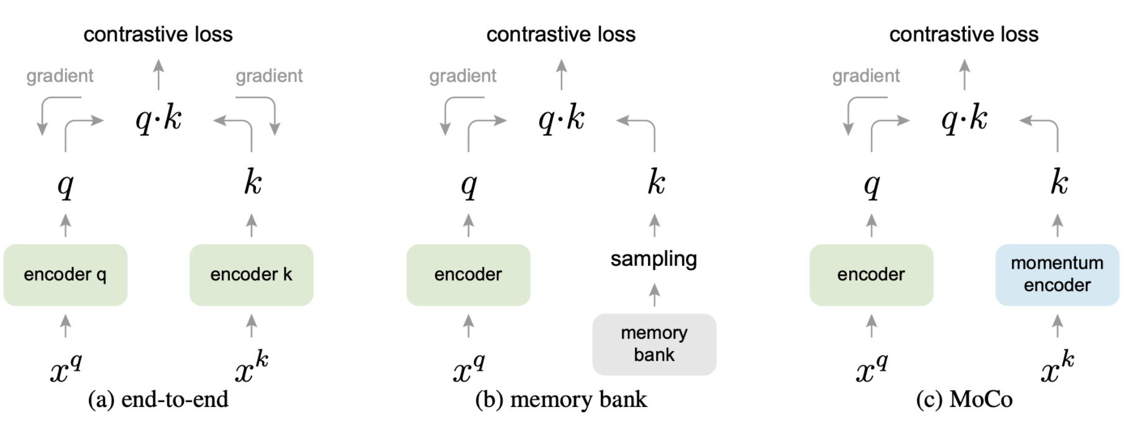
MoCo
k in a minibatch
k in training set
k in a queue

Slide 18
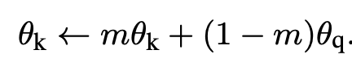
MoCo
k in a minibatch
k in training set
k in a queue
a relatively large momentum works better

Slide 19
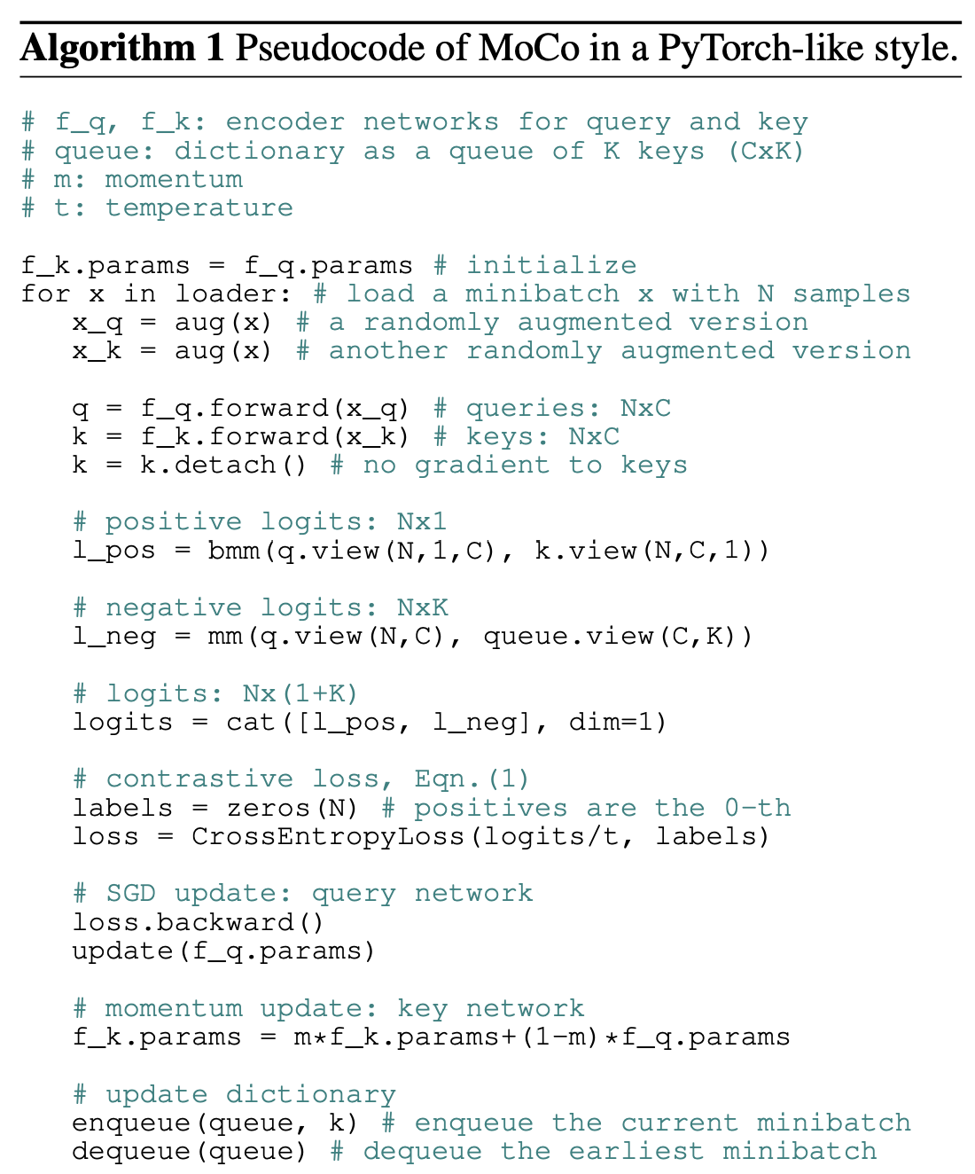
MoCo
Algorithm

Slide 20
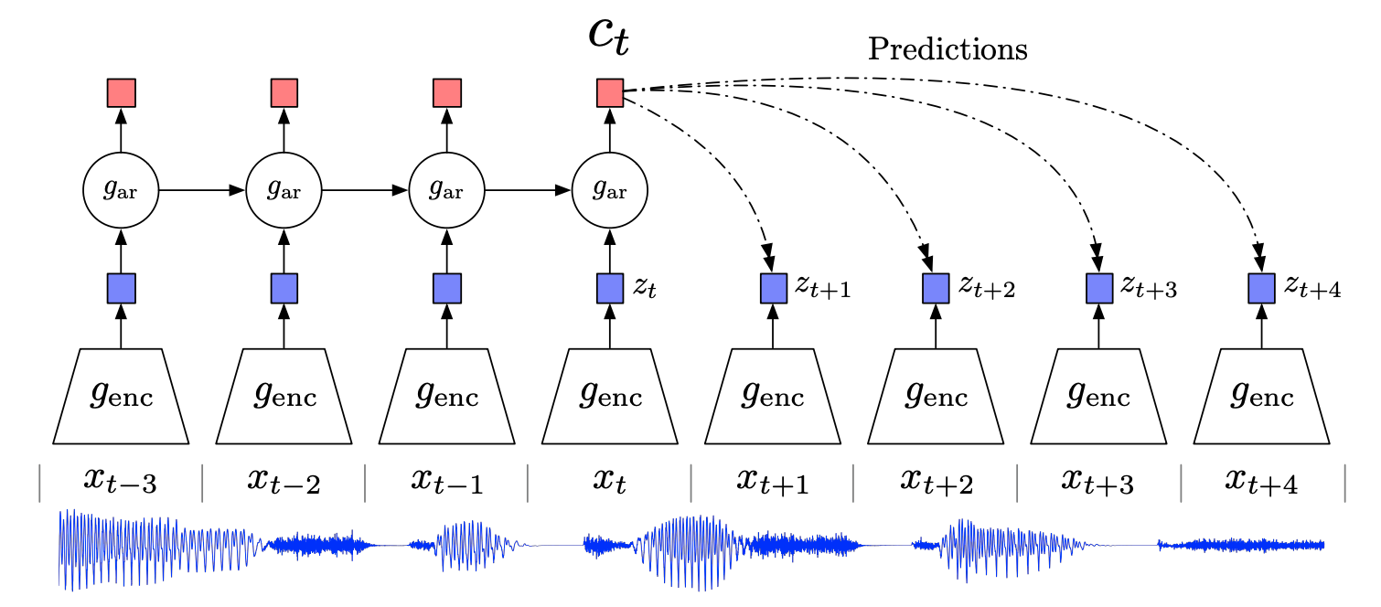
Representation Learning with Contrastive Predictive Coding (CPC)
DeepMind
2019
For any form
of data

Slide 21
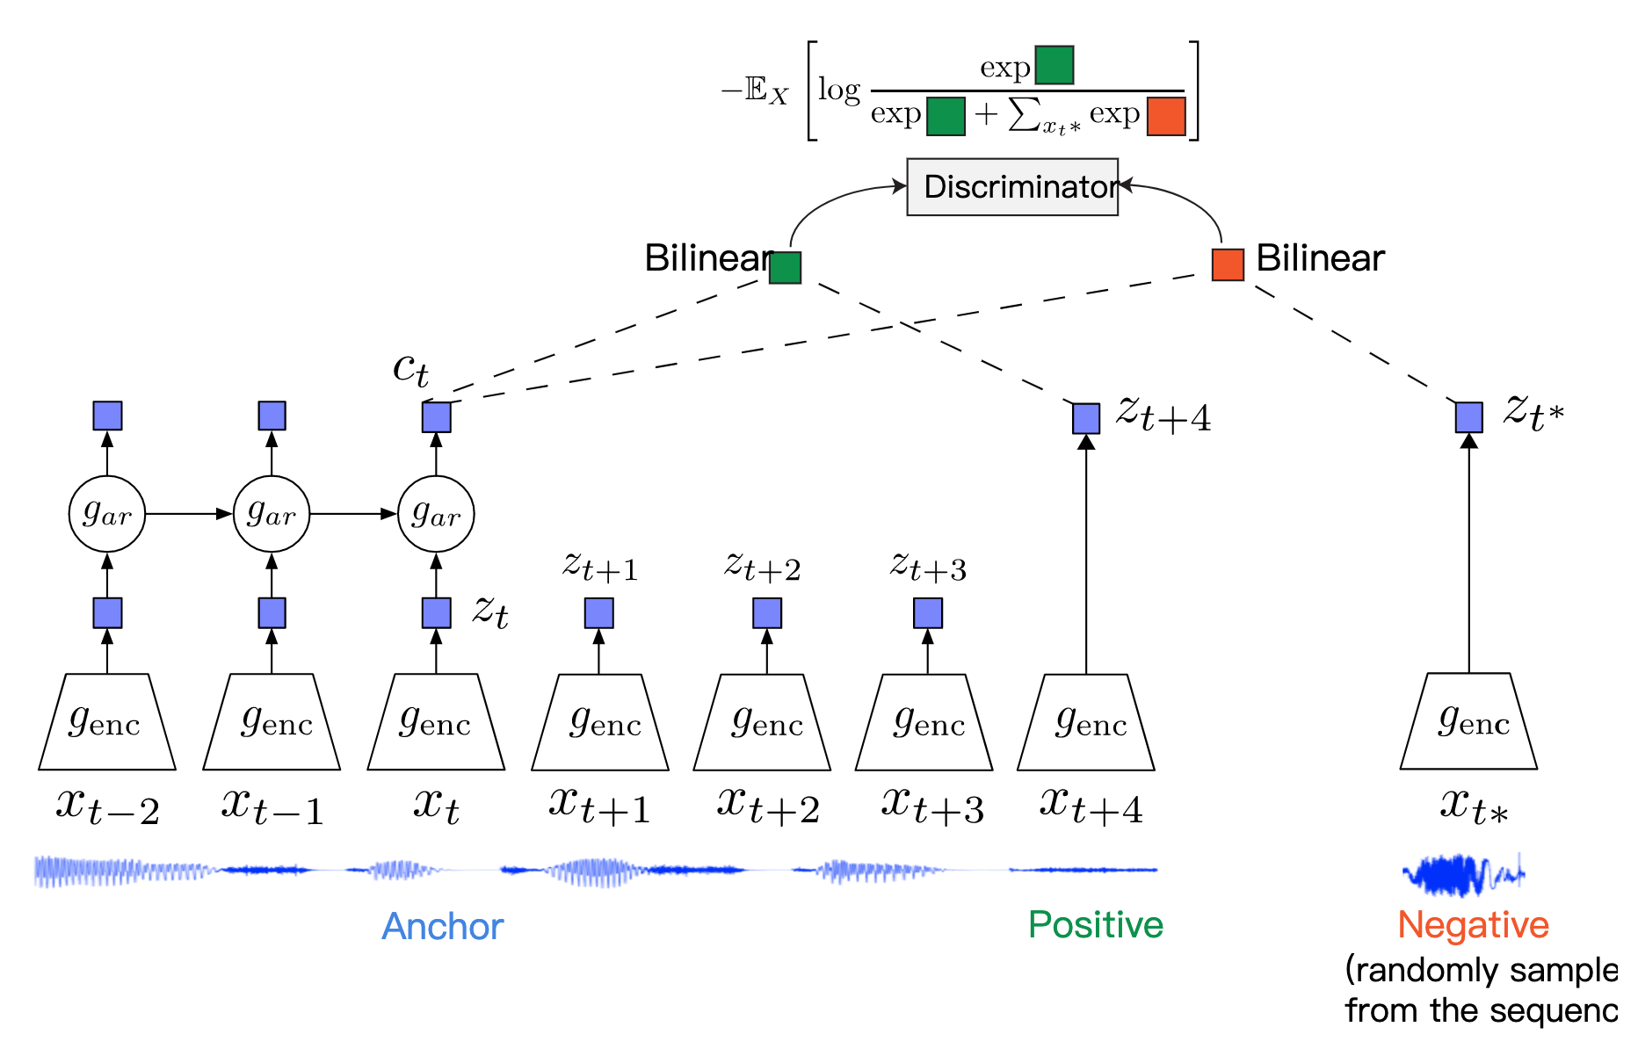
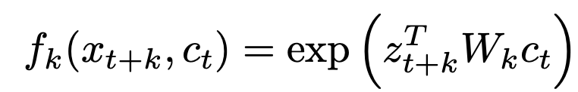
CPC
Let {x₁,x₂,…,x_{N}} be a sequence of data points, and x_{t} be an anchor data point. Then,
x_{t+k} will be a positive sample for this anchor.
A data point x_{t∗} randomly sampled from the sequence will be a negative sample.

Slide 22
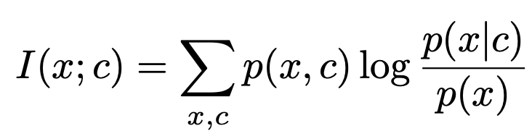
CPC
From the perspective of mutual information of x and context !
Main intuition: to learn the representations that encode the underlying shared information between different parts of the (high-dimensional) signal. When predicting further in the future, the amount of shared information becomes much lower, and the model needs to infer more global structure. These ‘slow features’ that span many time steps are often more interesting (e.g., phonemes and intonation in speech, objects in images, or the story line in books.).
Context c counts. Powerful conditional generative models are computationally intense, and waste capacity at modeling the complex relationships in the data x, often ignoring the context c.
Modeling p(x|c) directly may not be optimal for the purpose of extracting shared information between x and c. Images may contain thousands of bits of information while the high-level latent variables such as the class label contain much less information (10 bits for 1,024 categories).
Solution: to maximally preserve the mutual information of the original signals x and c:
= H(x) – H(x|c)

Slide 23
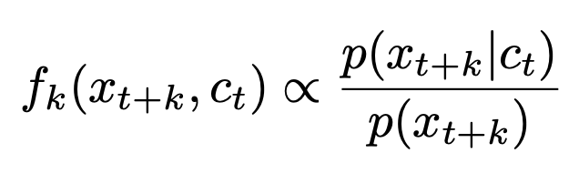
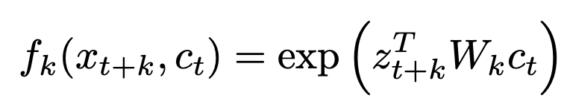
CPC
We do not predict future observations x_{t+k} directly with a generative model p_{k}(x_{t+k}|c_{t}). Instead we model a density ratio which preserves the mutual information between x_{t+k} and c_{t}
For simplicity

Slide 24
CPC
We do not predict future observations x_{t+k} directly with a generative model p_{k}(x_{t+k}|c_{t}). Instead we model a density ratio which preserves the mutual information between x_{t+k} and c_{t}
For simplicity
c_{t} * W_{k} to predict z_{t+k}
Thus, this is just a dot product

Slide 25
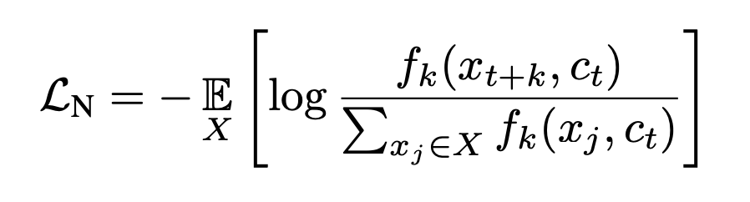
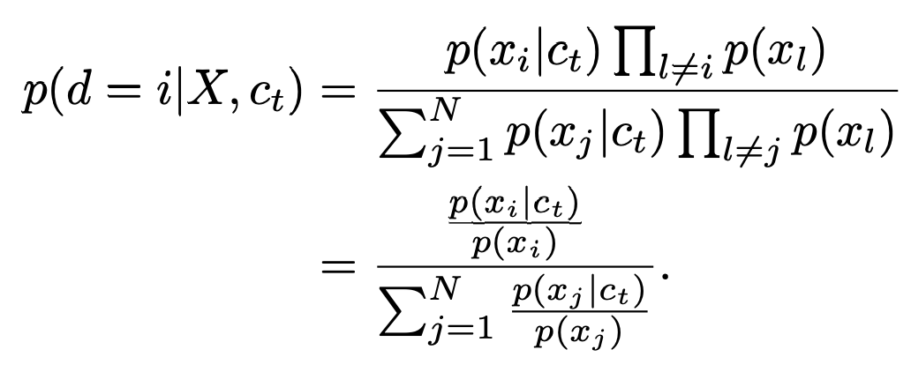
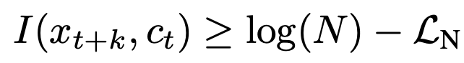
CPC loss
The categorical cross-entropy of classifying the positive sample correctly
The probability that sample x_{i} was drawn from the conditional distribution p(x_{t+k}|c_{t}) rather than the proposal distribution p(x_{t+k}) can be derived as follows
Proportional to mutual information
Additionally,

Slide 26
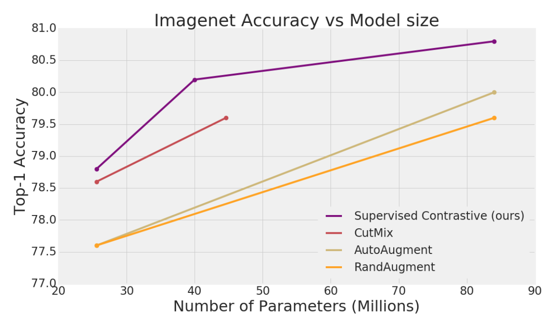
Supervised Contrastive Learning
MIT&Google
2020
modify the batch contrastive loss,
outperform cross entropy by over 1%

Slide 27
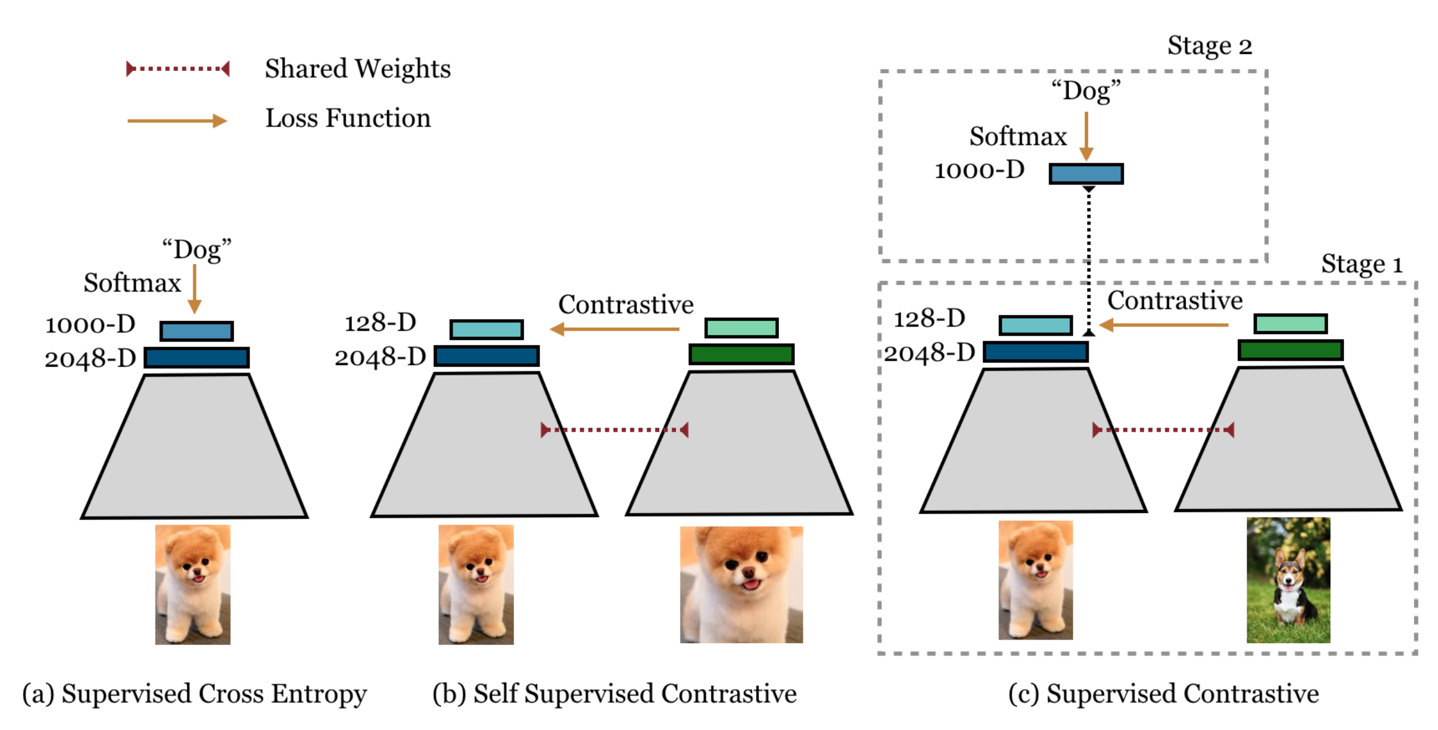

Slide 28
Thanks.
All of references please refer to https://shimo.im/docs/X6YHg9WpG3wjYXvH/ 「Contrastive Learning」

